Slide 1
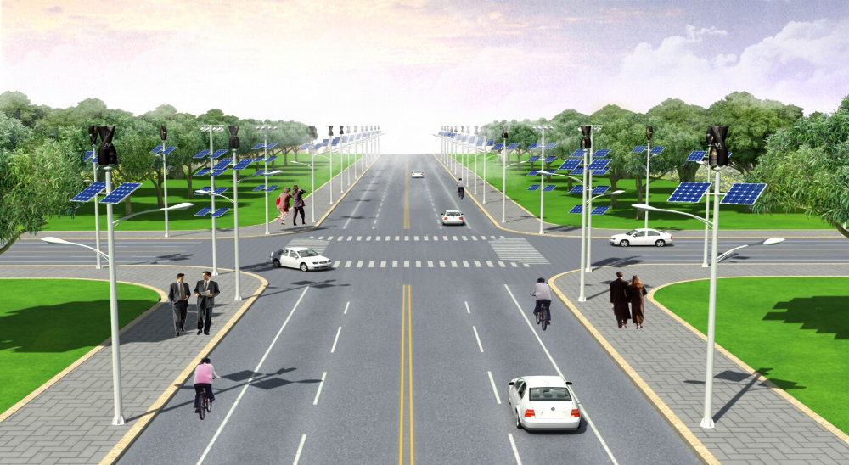

Hybrid STREET LIGHTING SYSTEMS
New hope USA INC.

Slide 2
Introduction:
Dear Customer,
Please allow us to introduce our self, New Hope U.S.A Incorporated is an innovative U.S base companies with plant in China to reduce labor cost and offer our consumers excellent quality with the best prices. Our company is dedicated to making this planet a better place. With the vision of becoming the world leader in the new generation of LED lighting and Hybrid Street light ( Solar & Wind ).
This is done by producing renewable resource technologies through new, innovative ideas.
Our company has embraced these ideas in hopes to provide global consumers with solutions to the ever-present quest for more efficient, environmentally friendly, and cost efficient energy sources.
NH will achieve these goals through determination, constant work ethic and efficiency. A constant cycle of new ideas and innovations will motivate the work force. It will inspire them to do their best. The work force will see the impact they are having on the world.
New Hope Lighting Arabia has been active in the Middle East/Asia’s market for a number of years. Our success has enabled us to expand and increase our sales presence in these markets and look forward to being able to offer you improved and more focused service going forward

Slide 3
Company profile
Established in 2007, in response to a growing need for greater energy efficiency in the worldwide lighting market. In the years that followed, New Hope USA inc has built a strong reputation for quality and reliable lighting solutions and is known worldwide.
In 2010, New Hope USA inc launched a scaled “distributed generation systems’ to complement any already well established LED lighting side of the business. The scaled distributed generation systems included Solar Photovoltaic (PV) Systems together with Vertical Axis Wind Turbines (VAWT). New Hope USA inc can supply a true hybrid system taking our nature’s sun and wind, providing a source of free, renewable and environmentally-friendly energy for homes and businesses. Partnering with leading solar power module manufacturers in the world and import only the best and most popular solar power inverters, together with the best products manufactured internationally, to provide our clients with top quality options for their wind and solar energy requirements.
In 2011, New Hope USA inc launched our Off-Grid Hybrid Street Lighting System.
This system takes all the advantages of wind and solar, and places them into everyday items
such as street lighting. Being totally off-grid, our Hybrid Street Lighting System can go anywhere
with the added bonus of not having to rely on a Mains Power Supply.
A real added feature for the very remote areas of the world.
2016 onwards, New Hope USA Inc is known as a front runner in LED lighting, small and large scale distributed generation systems. As part of our long-term growth strategy, we will continue to research and develop (R&D) systems to enable all people towards an
energy efficient future.

Slide 4


New Hope BillBoard 500w and 1000w turbines

Slide 5
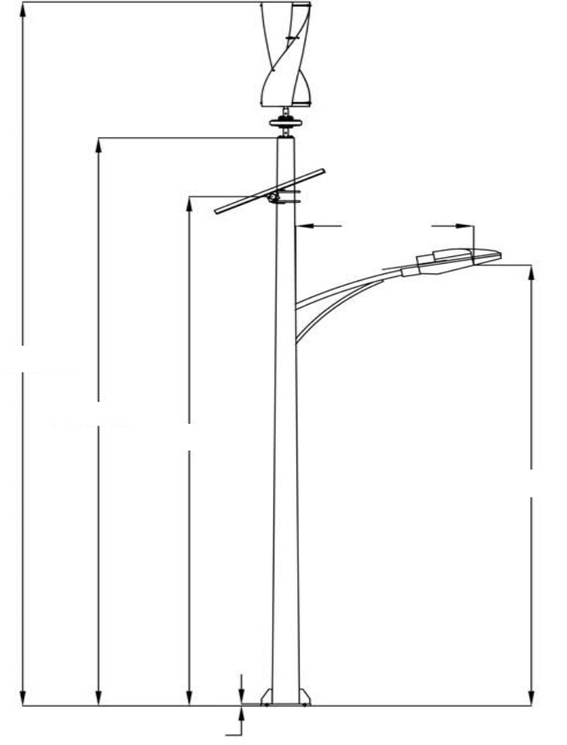
General description
New Hope USA Inc Hybrid Street Lighting Systems are designed off grid applications however a grid in system can also be designed.
Primary use in city streets, parking lots, highways or remote roads where grid power is not available.
The complete system includes New Hope USA Inc’s 100W vertical wind turbine, galvanised steel pole, solar panels, Lifepo4 lithium battery, high-tech hybrid smart controller and a LED street light with Luminous up to 130 LMW.
1100mm
10480mm
8480mm
7080mm
9200mm
7200mm
5800mm
8200mm
6200mm
4800mm
8000mm
6000mm
4600mm

Slide 6
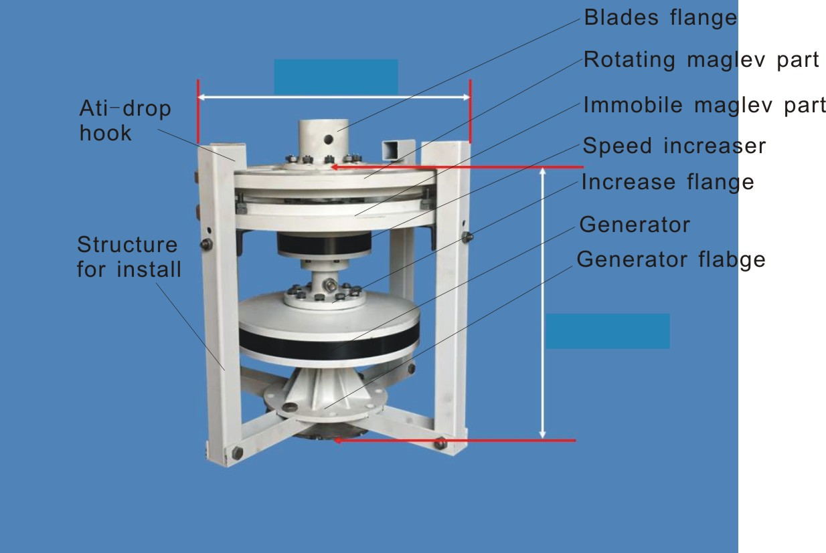
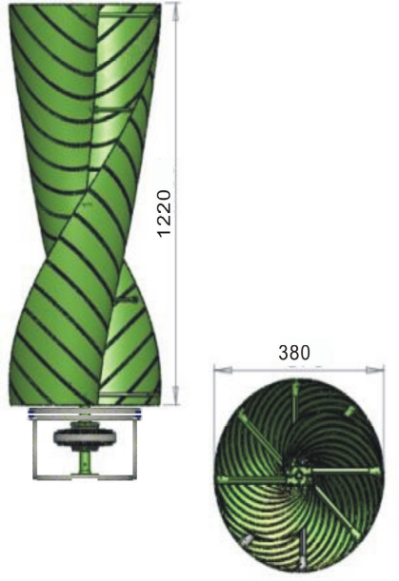
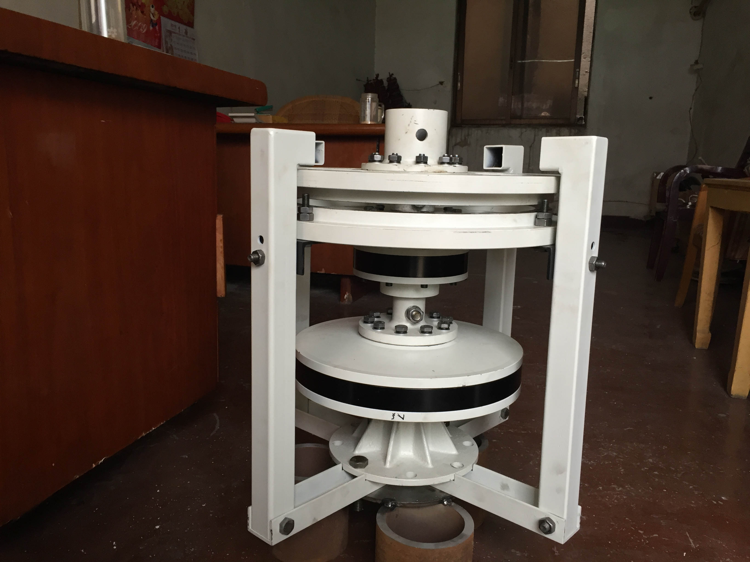
Vertical Axis Wind Turbine
CBF blade
The system blades are made from Continuous Basalt Fibre (CBF) which is light-weight, high strength (4 times stronger than steel with one fourth of the weight), corrosion resistant (150 years life span), great flexibility . Blades are smooth to allow customization for advertisements to be printed on them.
Perforated Blades to reduce wind resistance and increase efficiency.
Mag.lev. - Magnetic Levitation Generator
Our patented hub generator starts producing output power at wind speeds as low as 1 m/s w/ rated speed at 6.5 m/s making it the most efficient generator of it’s type on the world’s market.

Slide 7
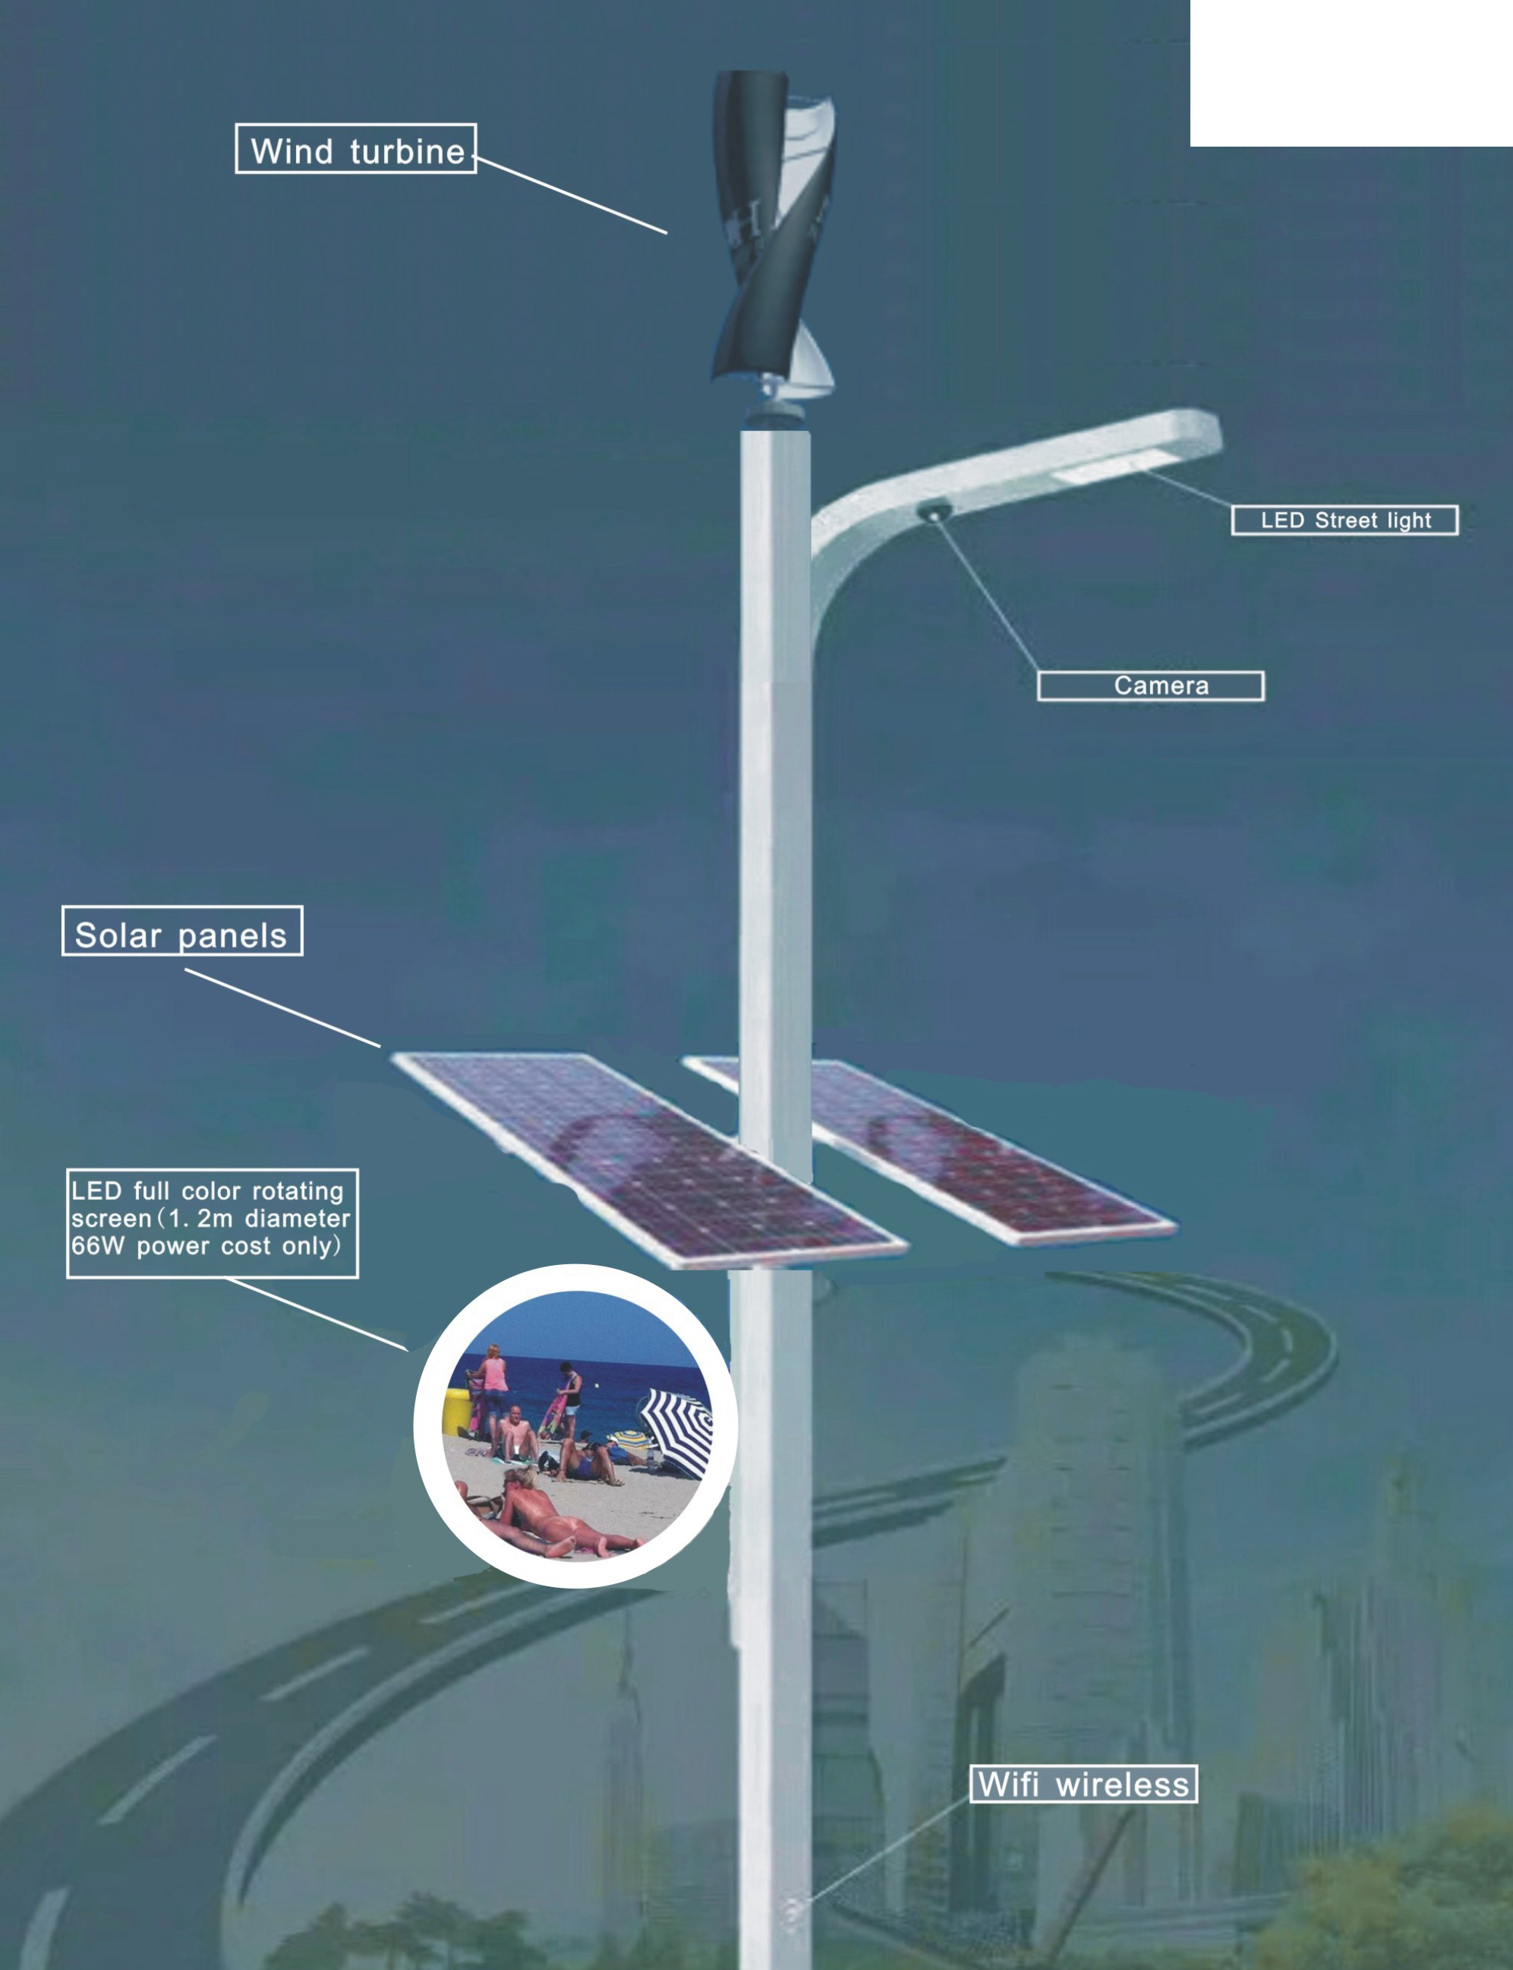
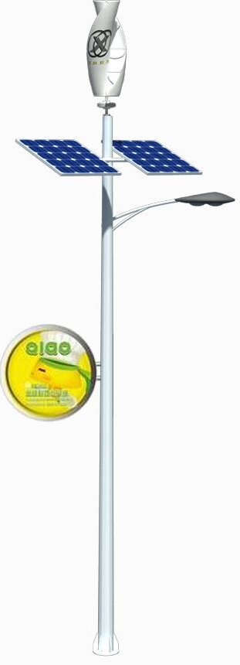
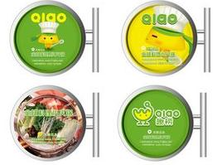
Hybrid street light with our patented LED Rotating screen, wifi modem and monitoring camera

Slide 8
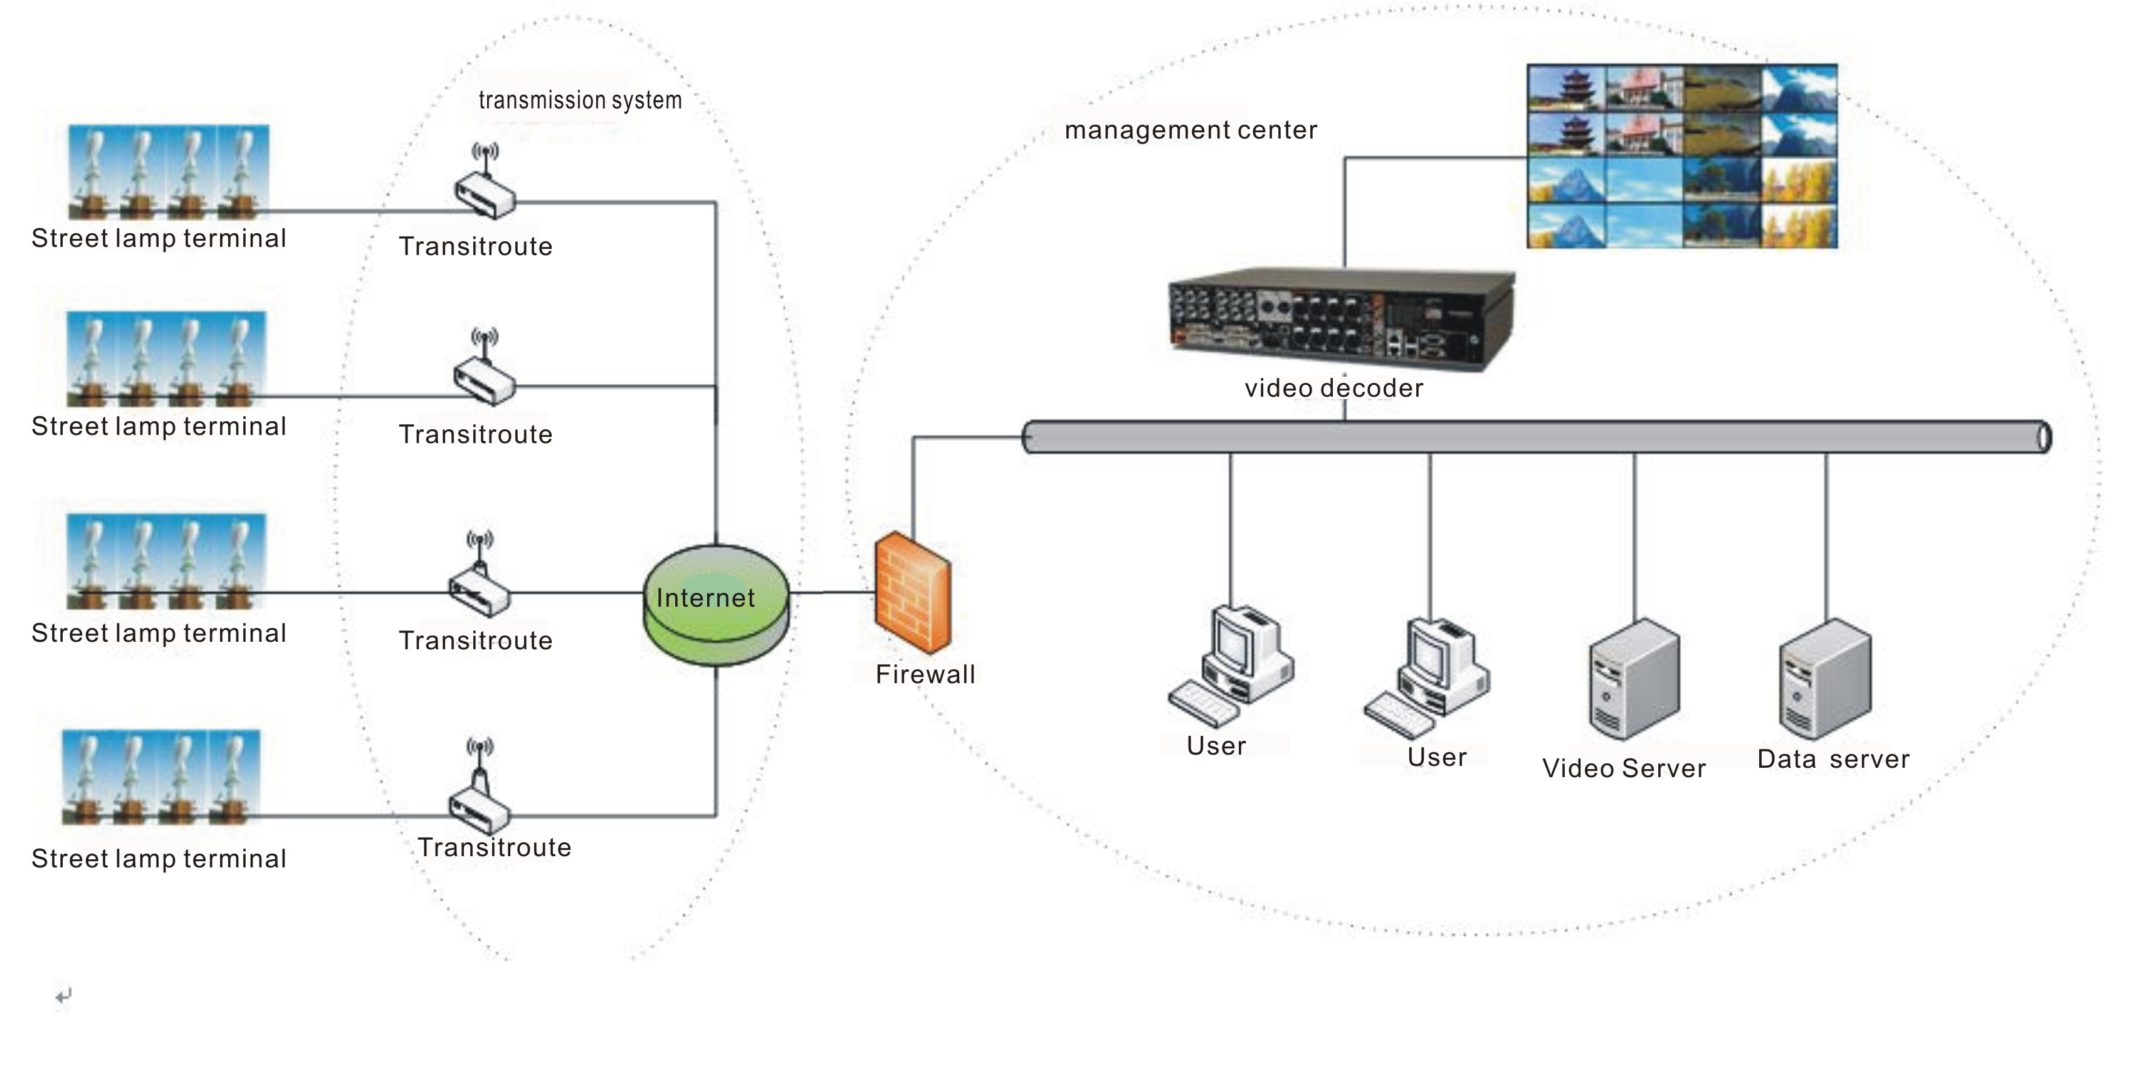
Complete Monitoring system

Slide 9
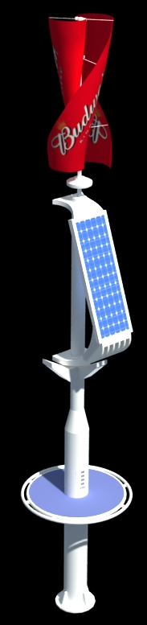
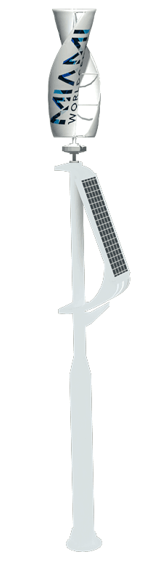
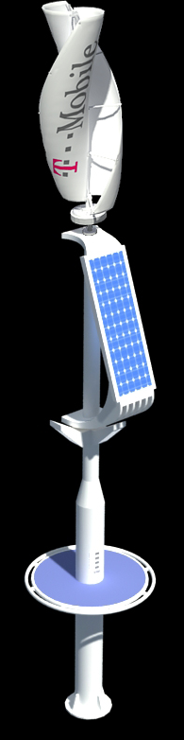
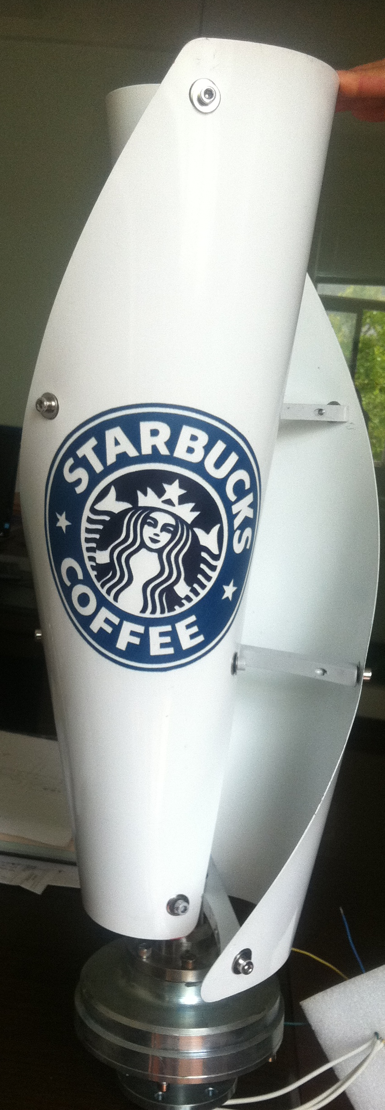
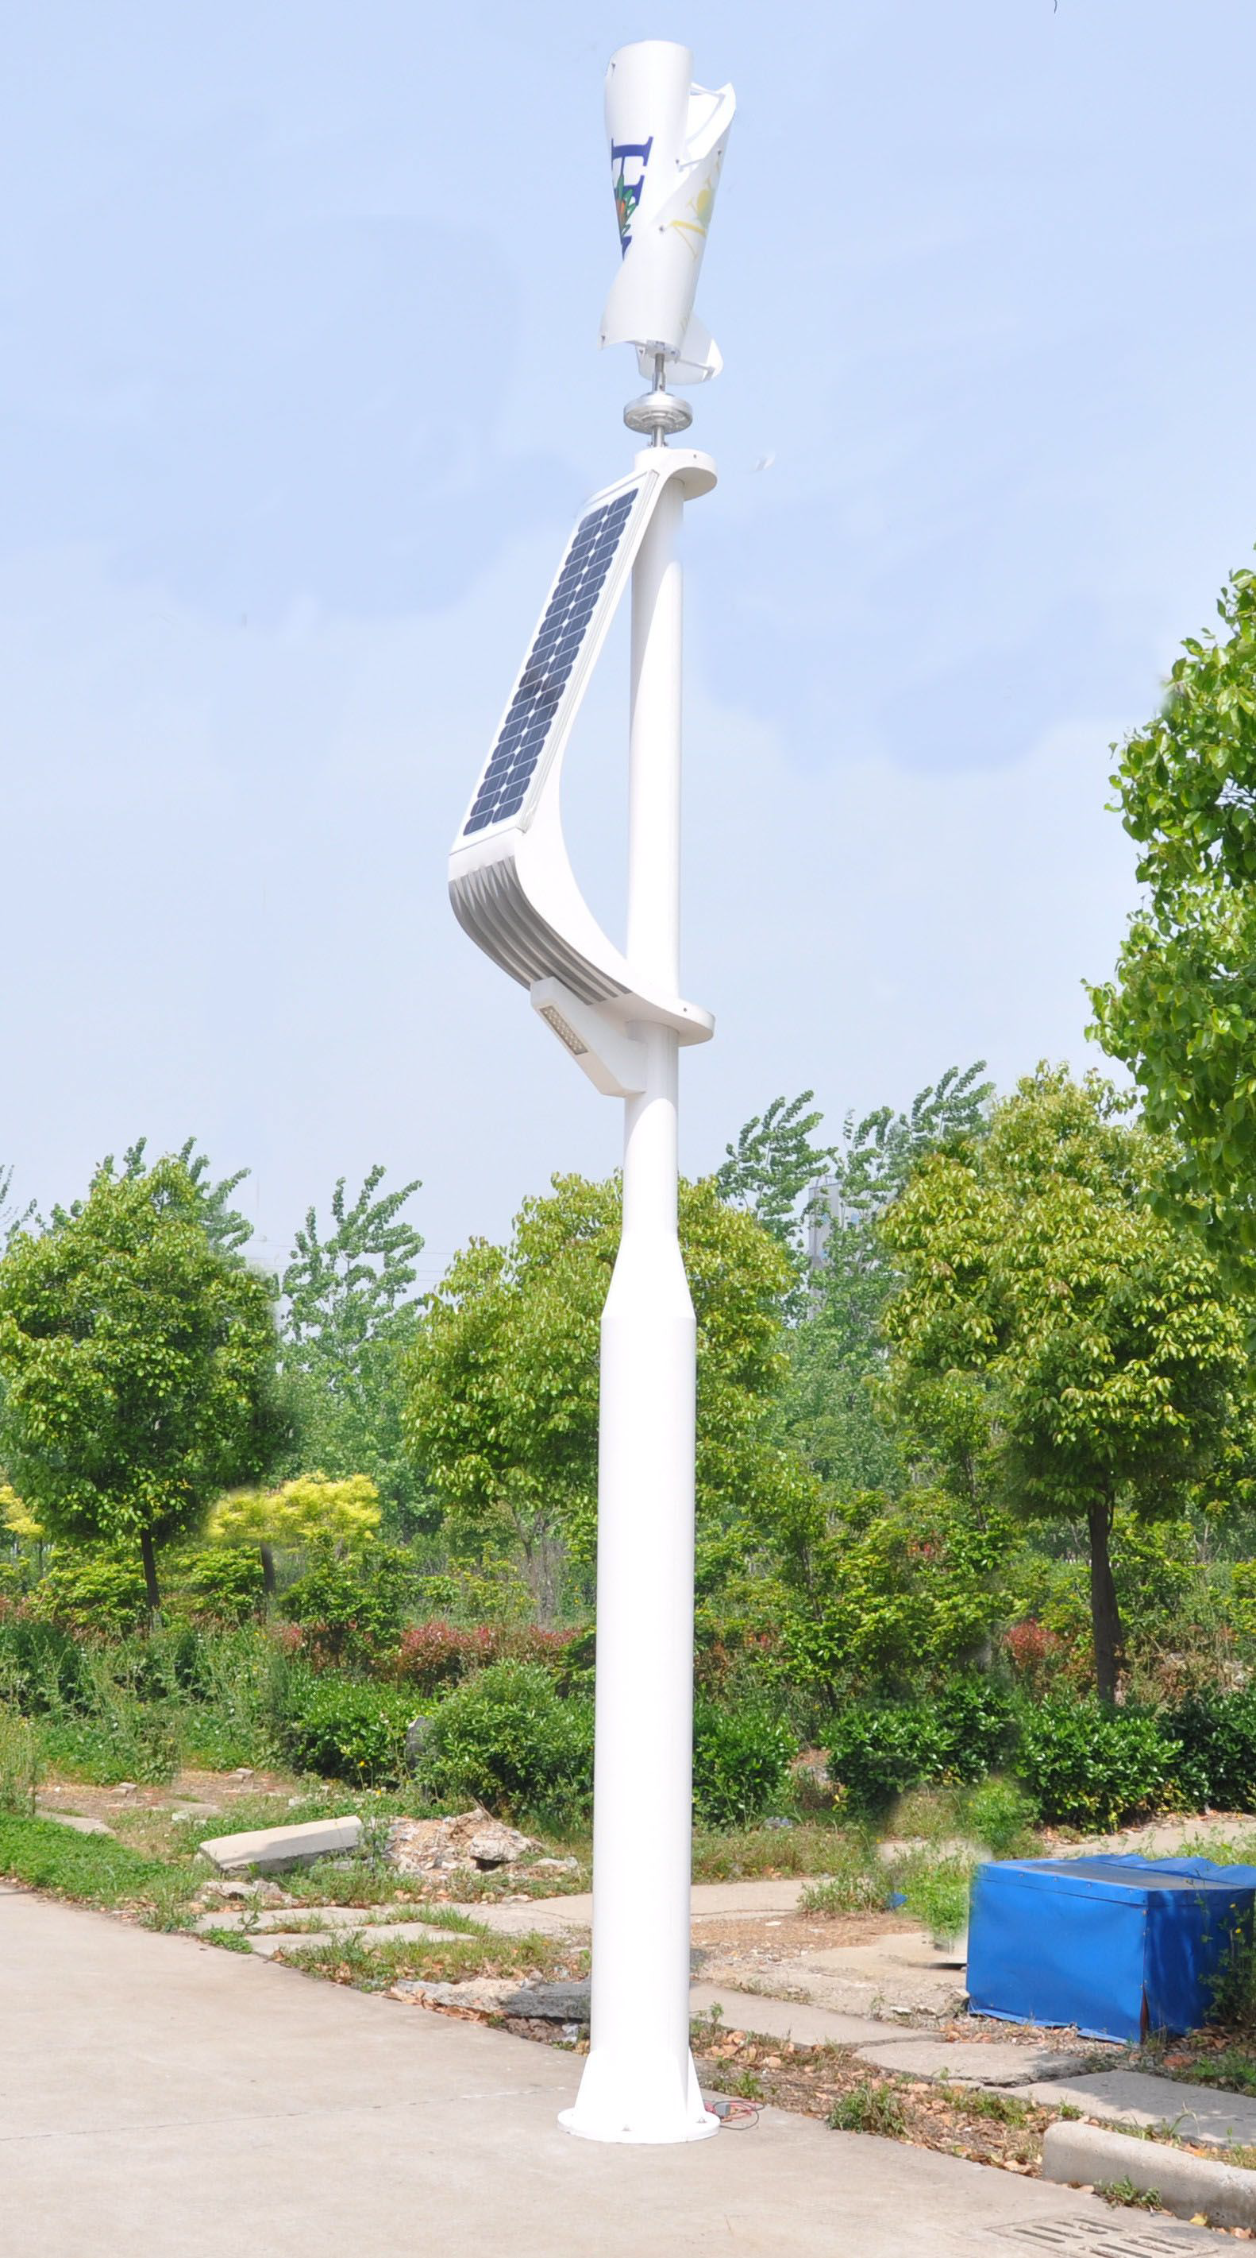
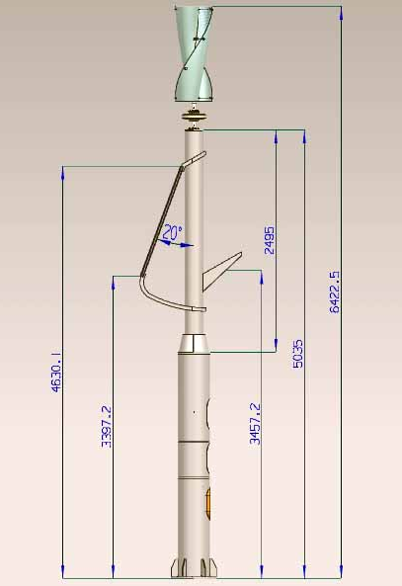
Mobile Hybrid park light with customized blades logo & Usb port charger

Slide 10
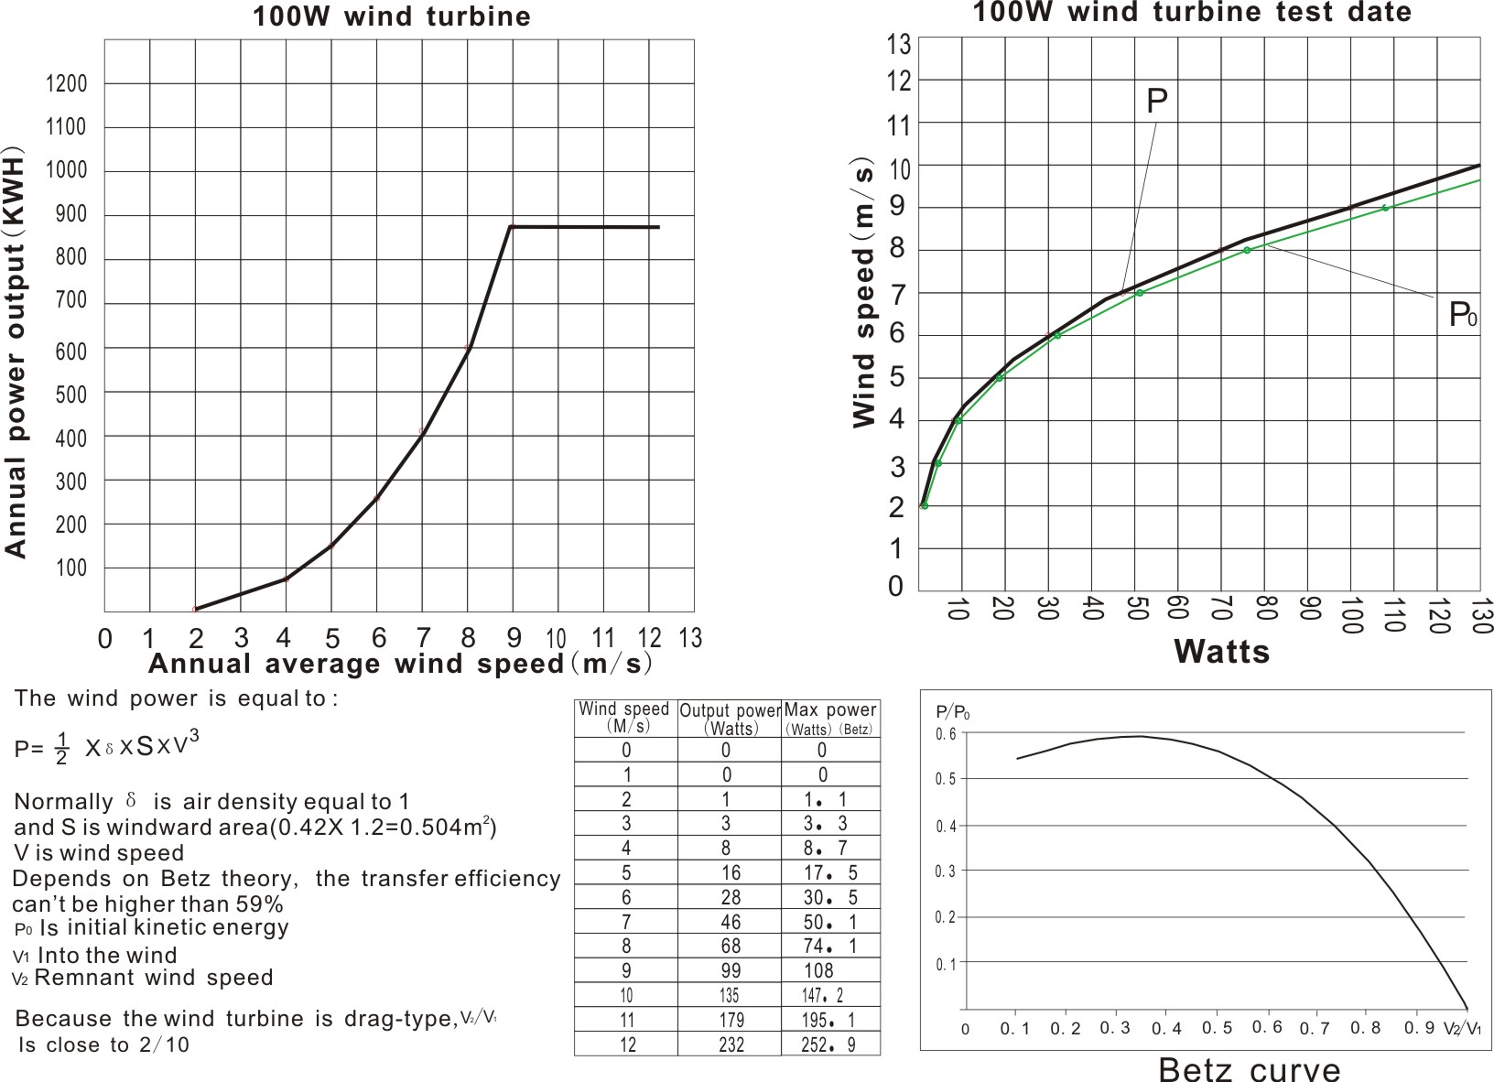
Vertical Axis Wind Turbine
BETZ Limit
With our patented design mag.lev. generator along with our blade design the complete efficiency can break the Betz limit.

Slide 11
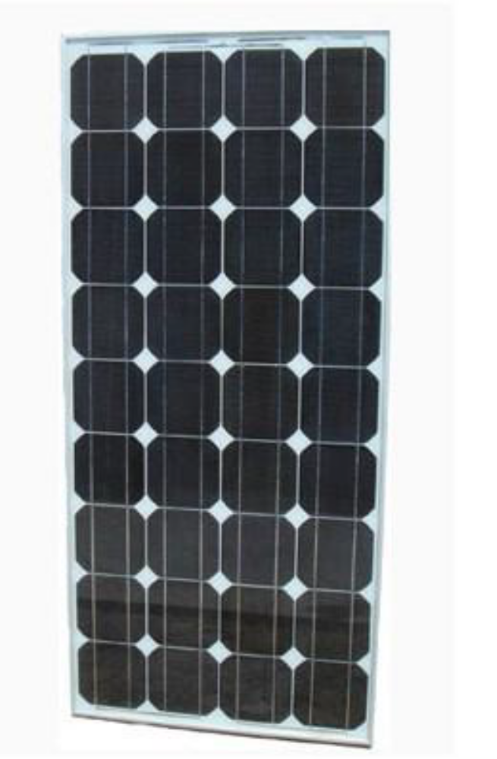
Solar panel
We use Polycrystalline or Monocrystalline Photovoltaic Modules depending on area of installation, features include:
High cell efficiency with quality silicon material for long term output stability and reliability
High transmittance, low iron tempered glass with enhanced stiffness and unique frame design with high mechanical strength for easy installation
Advanced encapsulation material with multi-layer sheet lamination for efficient protection from the most severe environmental conditions
Outstanding electrical performance under high temperature and low irradiance conditions
ISO 9001:2008 Quality Management Systems, CQC Certificate, CE Certificate & SGS-TUV Certificates along with IEC61215 & IEC61730

Slide 12
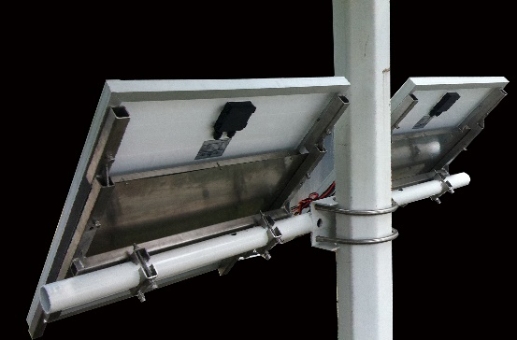
Lithium ion Batteries
With today’s demand for longevity and performance, our hybrid street lighting systems use either Gel or Lithium Ion (LiFePO4) batteries for energy storage. This ensures full discharge capacity is available giving over 5 years for gel and 10 years battery life if a full cycle is used every night which is very unlikely as there is normally solar photovoltaic or wind energy supplementing LED street head energy use.
We place the LiFe batteries behind the solar panels so all hybrid working are above ground and for gel batteries we could either put it under ground or hang it in the center of the pole.

Slide 13
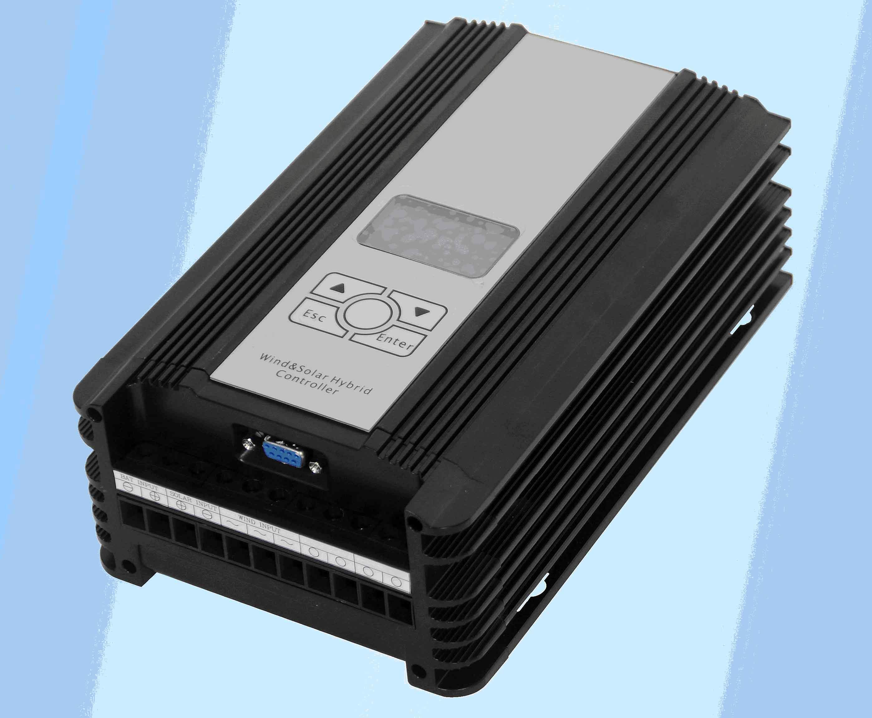
high-tech hybrid smart controller
The brain behind our hybrid street lighting solution is the intelligent Wind/Solar Hybrid MPPT Power Management Controller, a wind energy & solar senior energy manager. Internally it integrates a high efficient LED driver, wind MPPT tracking system and solar MPPT tracking system. The new design concept and the open user-level application configuration extend the controller's application, giving precise control of energy input and output

Slide 14
high-tech hybrid smart controller
Main features of our controller are:-
Provide wind generators Maximum Power Point Tracking (MPPT) channel
Provide solar input Maximum Power Point Tracking (MPPT) channel
Provide LED driver with 120W output, maximum efficiency up to 95%
High brightness 3-digital display, setting parameters
Fan/solar input channel reverse connect, protect from over current, overloading and lightning
Output channel protection (open circuit, short circuit, overloading, opposite connect, lightning)
Battery input opposite connect
Battery over charge/discharge protection, safe charge management can repair battery during charging period, extends the battery lifetime greatly
Fan auto/manual unloading function, the unique unloading control technology ensures fan's smooth braking, to avoid large inertia change, and improve the mechanical life of fan
Provide electricity switching function as needed. When the battery runs down, switch to electricity automatically; keep the output stable and effective
Reserved RS232 communication interface can provide communication management function. Making expanding of wireless telecommunications possible

Slide 15
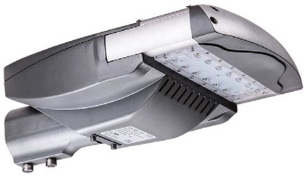
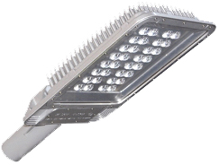
LED Streetlight
Our own LED head units has a professional encapsulation of materials which utilizes the highly efficient Philips LUMILED chip, making the LED light source obtain excellent protection of optical attenuation and heat conduction ratio.
Also utilizing world leading Mean Well LED Drivers, this ensures great luminaire stability, lifespan & optimal performance status.
The use of the good thermal grease combining MCPCB and the aluminum radiator closely, keeps every LED obtaining optimal effects of heat dissipation. Light attenuation of LEDs under safe control with adequate heat sinking area and excellent air flow design.
Optional monitoring hardware can be installed if requested to allow complete hybrid system checks and control.

Slide 16
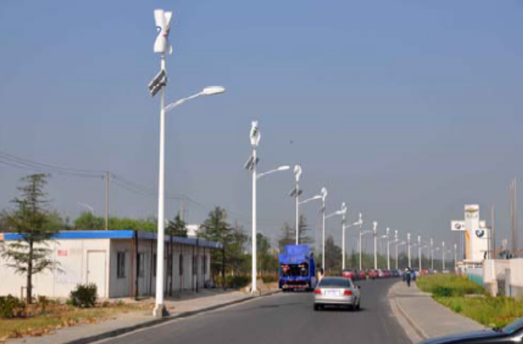
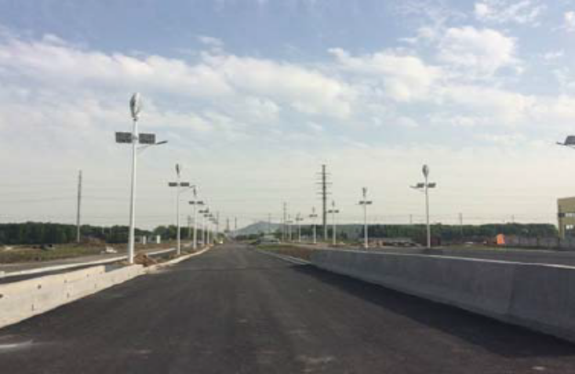
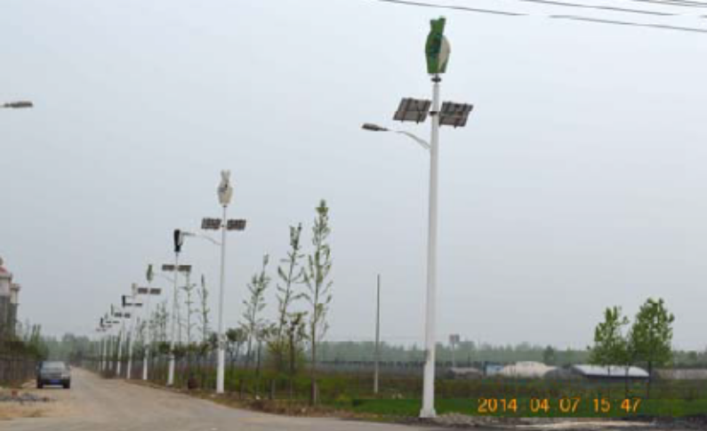
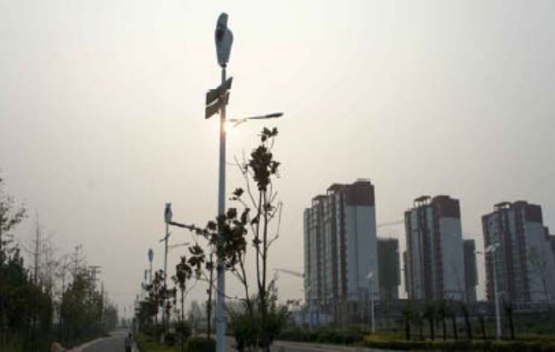
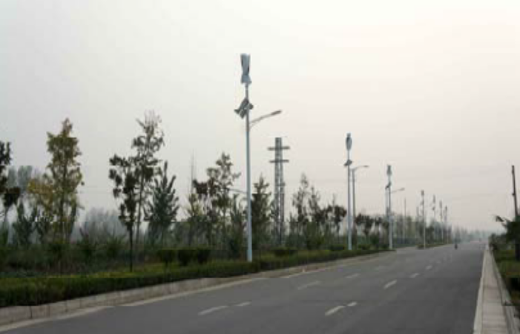
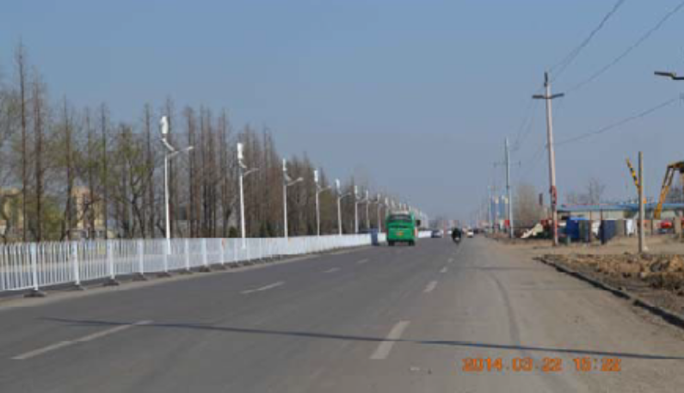
Hybrid installations world wide

Slide 17
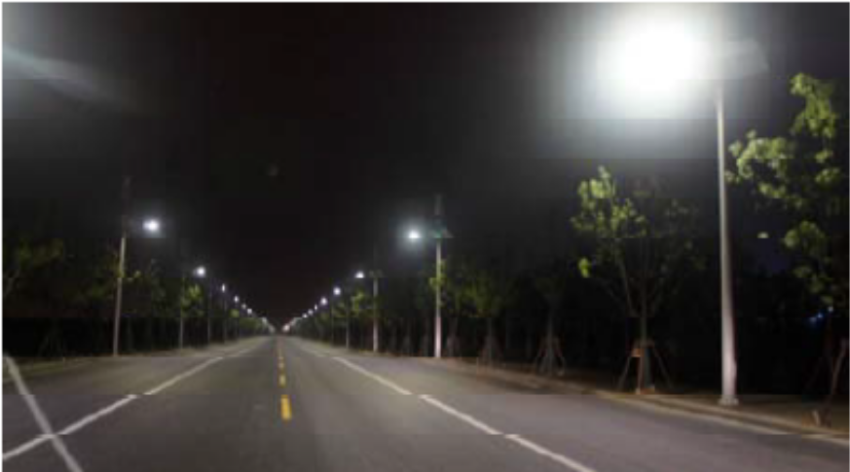
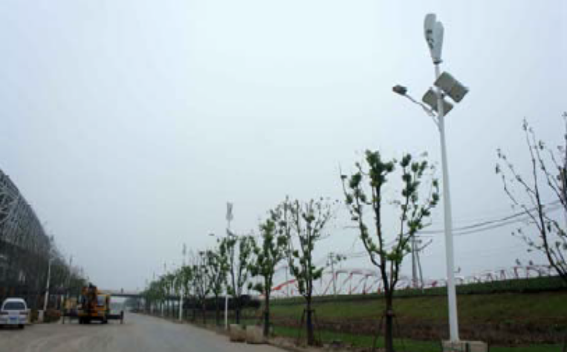
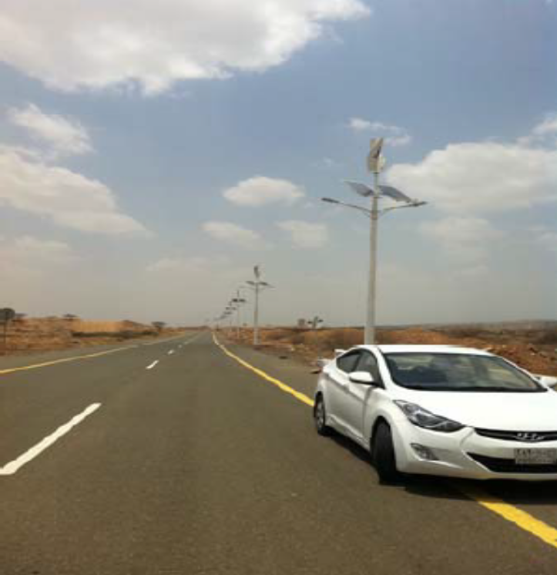
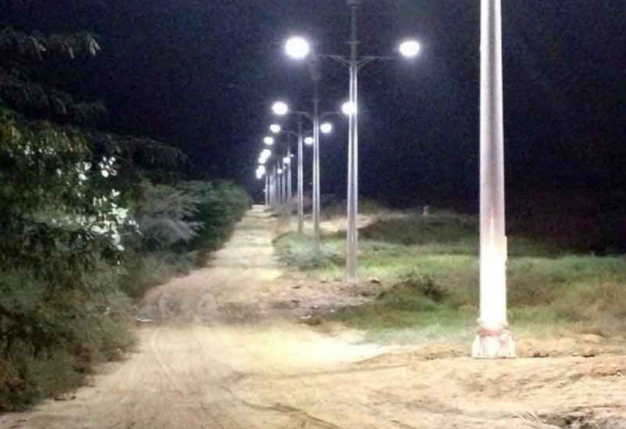
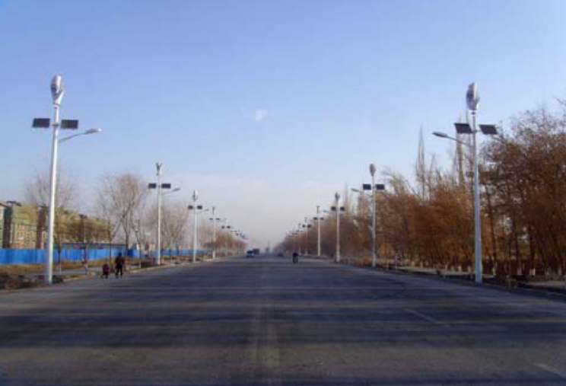
Hybrid installations world wide

Slide 18
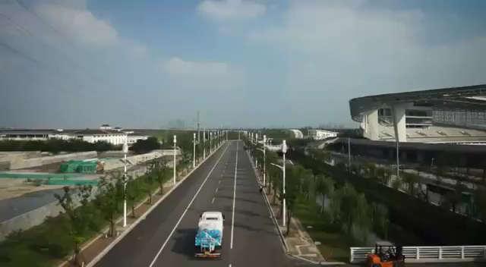
Watch our videos for our Hybrid street light projects world wide on Youtube.
Click on play below to watch video
https://www.youtube.com/watch?v=sQeh08olX9s
New Hope animated video
https://www.youtube.com/watch?v=OTbUqnBQDKQ
New Hope USA Inc., 2014 project for the world youth Olympic Stadium in Nanjing - china.
https://www.youtube.com/watch?v=JR9Rxez_yO0
2014 project of Hybrid street light 2 arms with infrared surveillance camers on the border of Yemen and Saudi Arabia
https://www.youtube.com/watch?v=GLzr-gA_ngo
This is another project that we did in Jiangsu province in China.
https://www.youtube.com/watch?v=9C-46Vk7bUA
This project was done in Puerto Rico as retro fit to existing local pole.
https://www.youtube.com/watch?v=o5n9PA8lOVQ
This Hybrid street light was installed in Palm Beach County, Florida USA.
https://www.youtube.com/watch?v=No-Hy4qv7lM
4 turbines to charge cell phone tower video

Slide 19
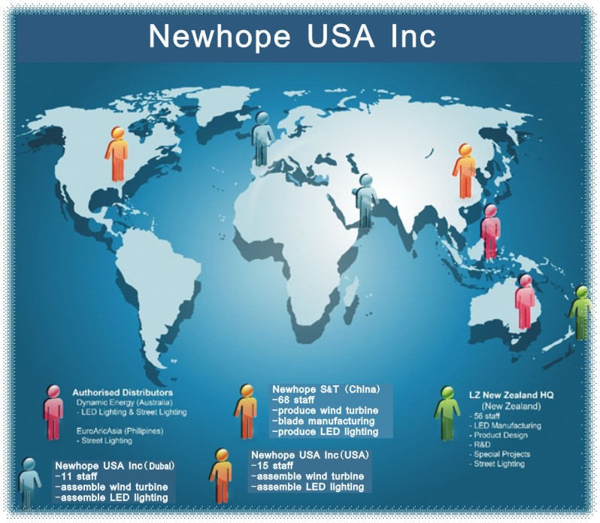
New Hope USA Inc parent company is based in USA and operates in a number of international markets.
In line with our long-term growth strategy and number of global projects underway, several new offices are planned for 2016.

Slide 20
Thank You
Eng. Del Zatar
President of Global Sales & Marketing for New Hope U.S.A Inc.,
750 South Powerline Road Bldg. 5 Suite G
Deerfield Beach, Florida 33442. U.S.A
Tel 877-903-6767
Fax 954-486-5886
Cell 954-881-8705
E-Mail: sales@newhopeus.com
Web: www.newhopeus.com / www.streetvizion.com
New Hope USA the answer to greener planet

